Slide 1

Mindfulness 101
Week 4

Slide 2
Class Flow
01
02
03
04
Check-in and Recap
Mini Lesson
Mindfulness
Practice
Prep for next week / QA

Slide 3

Check-In
Rose-Bud-Thorn

Slide 4
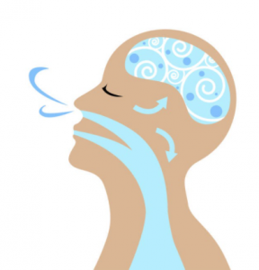
Mindful Breathing

Slide 5
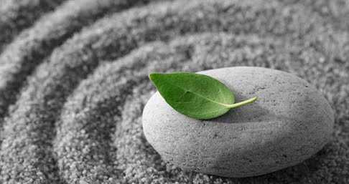
Mindfulness
A particular type of awareness that arises through paying attention to the moment, on purpose and non-judgmentally
...more simply, practicing mindfulness is learning to notice our experiences in the moment with intention

Slide 6
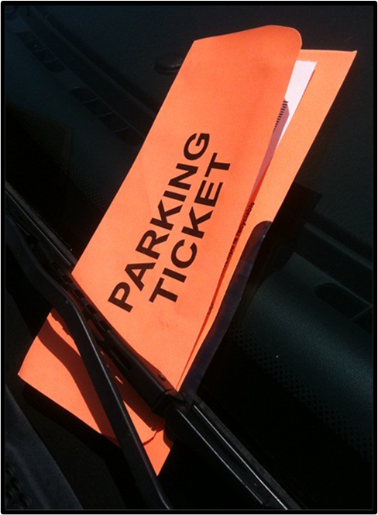
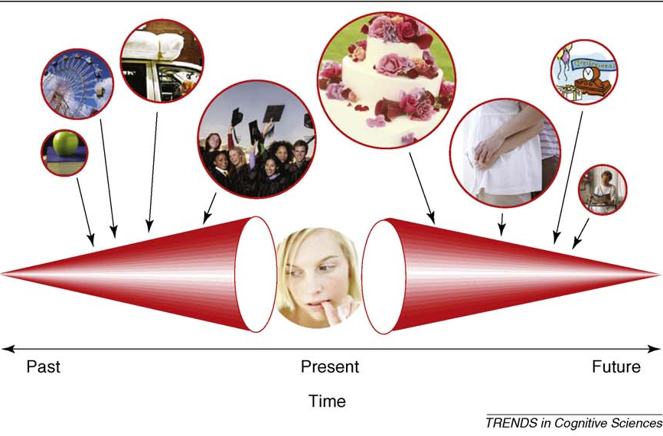

Mindfulness
A particular type of awareness that arises through paying attention to the moment, on purpose and non-judgmentally

Slide 7
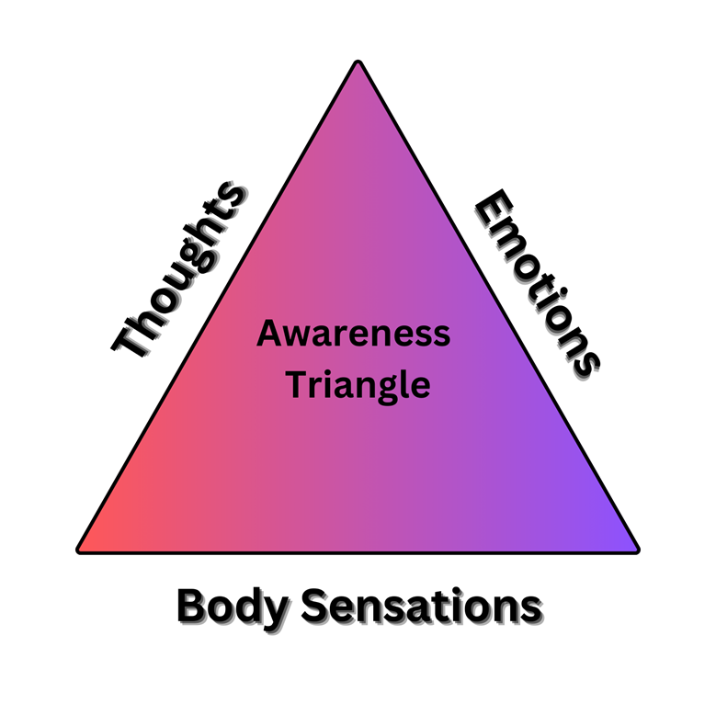
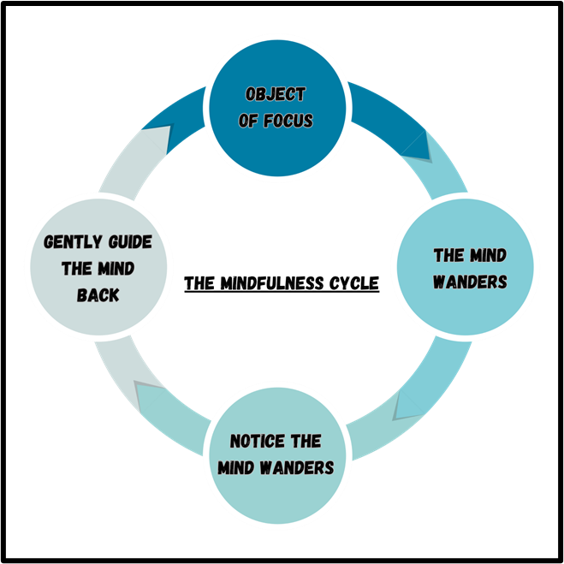
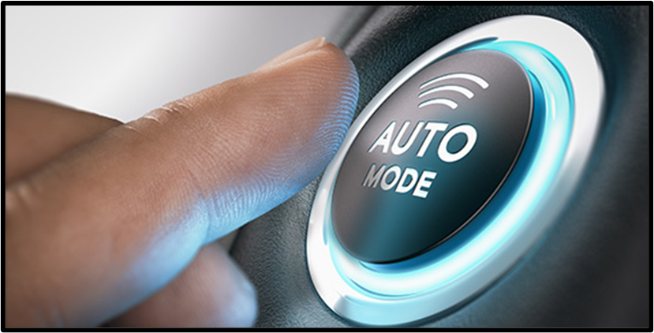
Mindfulness
A particular type of awareness that arises through paying attention to the moment, on purpose and non-judgmentally

Slide 8
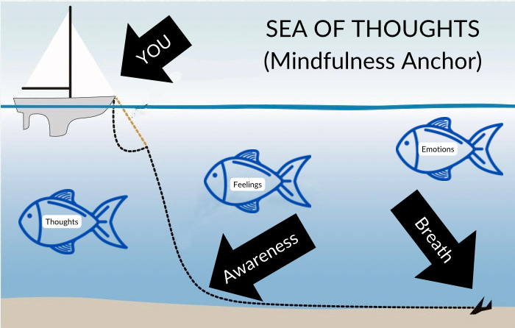
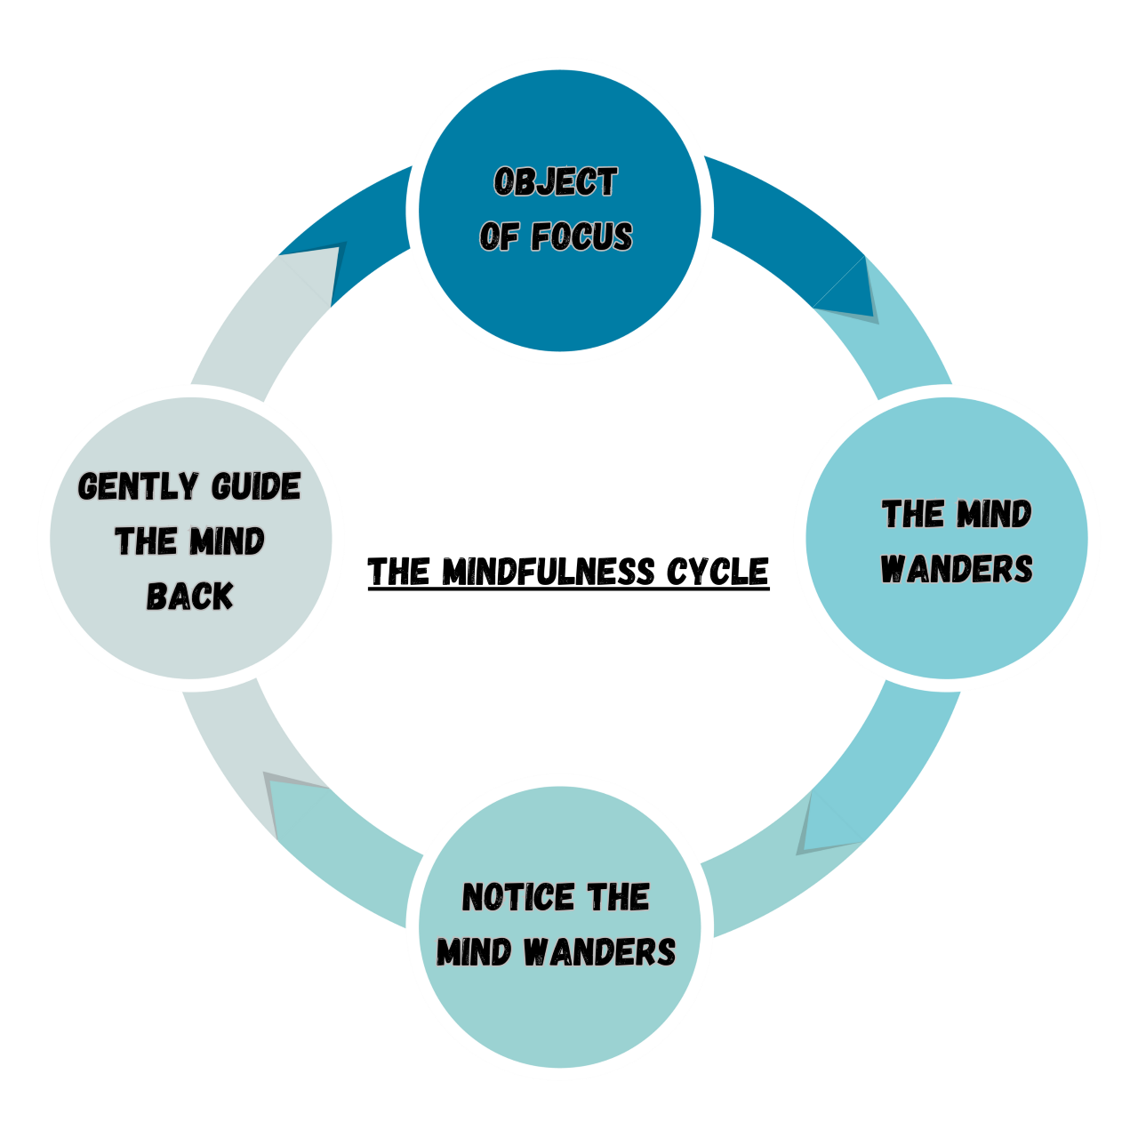
Mindfulness
A particular type of awareness that arises through paying attention to the moment, on purpose and non-judgmentally

Slide 9
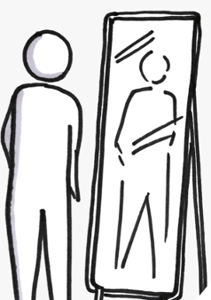
Just Like Me

Slide 10
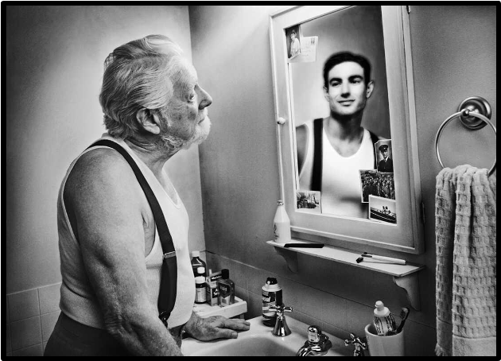
The Guy in the Glass
by Dale Wimbrow
When you get what you want in your struggle for pelf,
And the world makes you King for a day,
Then go to the mirror and look at yourself,
And see what that guy has to say.
For it isn't your Father, or Mother, or Wife,
Who judgement upon you must pass.
The feller whose verdict counts most in your life
Is the guy staring back from the glass.
He's the feller to please, never mind all the rest,
For he's with you clear up to the end,
And you've passed your most dangerous, difficult test
If the guy in the glass is your friend.

Slide 11
The Guy in the Glass
by Dale Wimbrow
You may be like Jack Horner and "chisel" a plum,
And think you're a wonderful guy,
But the man in the glass says you're only a bum
If you can't look him straight in the eye.
You can fool the whole world down the pathway of years,
And get pats on the back as you pass,
But your final reward will be heartaches and tears
If you've cheated the guy in the glass.

Slide 12
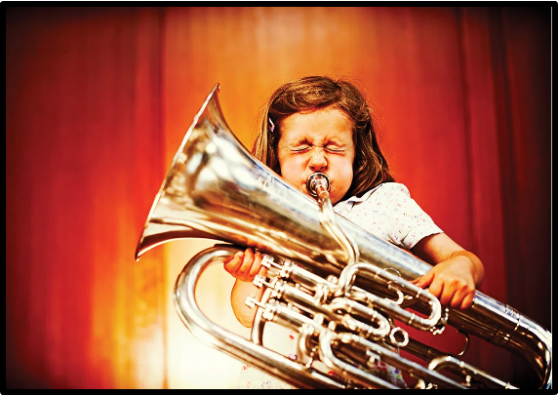
Mindfulness Practice … Emphasis on “Practice”

Slide 13
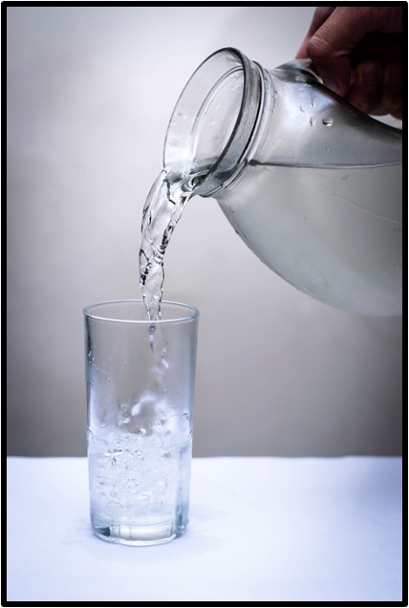
Fill Up Your Cup
Engage in a hobby
Practice gratitude
Connect with nature
Prioritize sleep and rest
Set boundaries
Engage in physical activity
Engage in self-reflection
Prioritize time for practice and self-care
Positive affirmations
Intention setting

Slide 14

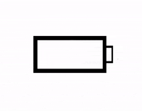

Energy Exchange
NOT YOUR FAULT

Slide 15

Radar

Slide 16
Mindfulness Practice … Emphasis on “Practice”

Slide 17
Bio-Break

Slide 18

Metta Practice

Slide 19
Metta Practice
May I be happy...
May I be peaceful...
May I be safe...
May I feel and know love...
May you...
May all beings...

Slide 20
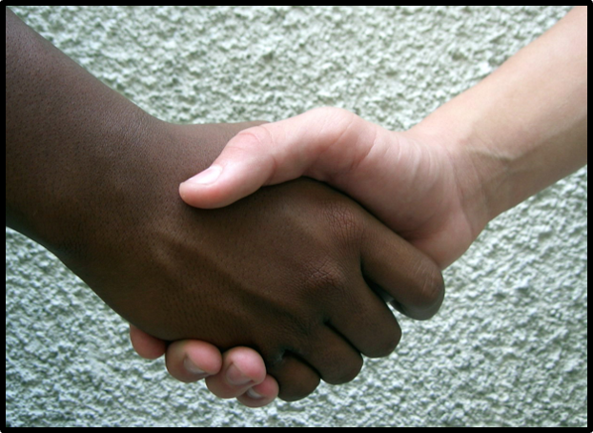
A Time to Talk
by Robert Frost
When a friend calls to me from the road
And slows his horse to a meaning walk,
I don’t stand still and look around
On all the hills I haven’t hoed,
And shout from where I am, What is it?
No, not as there is a time to talk.
I thrust my hoe in the mellow ground,
Blade-end up and five feet tall,
And plod: I go up to the stone wall
For a friendly visit.

Slide 21
Homework
1) Continue with your practice
2) Join a free community practice
3) Thank yourself for taking moments to practice self-care
4) Email any comments, feedback, praise, or suggestions to:
engage@copperbeechinstitute.org
5) Find a reason to smile

Slide 22
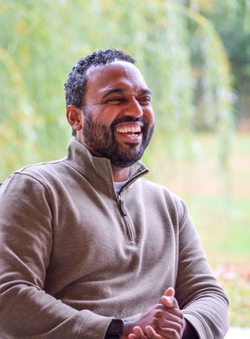
Thank You!
Have questions?
engage@copperbeechinstitute.org
Copper Beech Institute

